Slide 1
SWE 312 Final Presentation Dhahran Health Clinic
Group 5 | Hashim Alghamdi – Haitham Alsaeed – Salem Bamukhier – Salman Alghamdi

Slide 2
Use Case Model

Slide 3
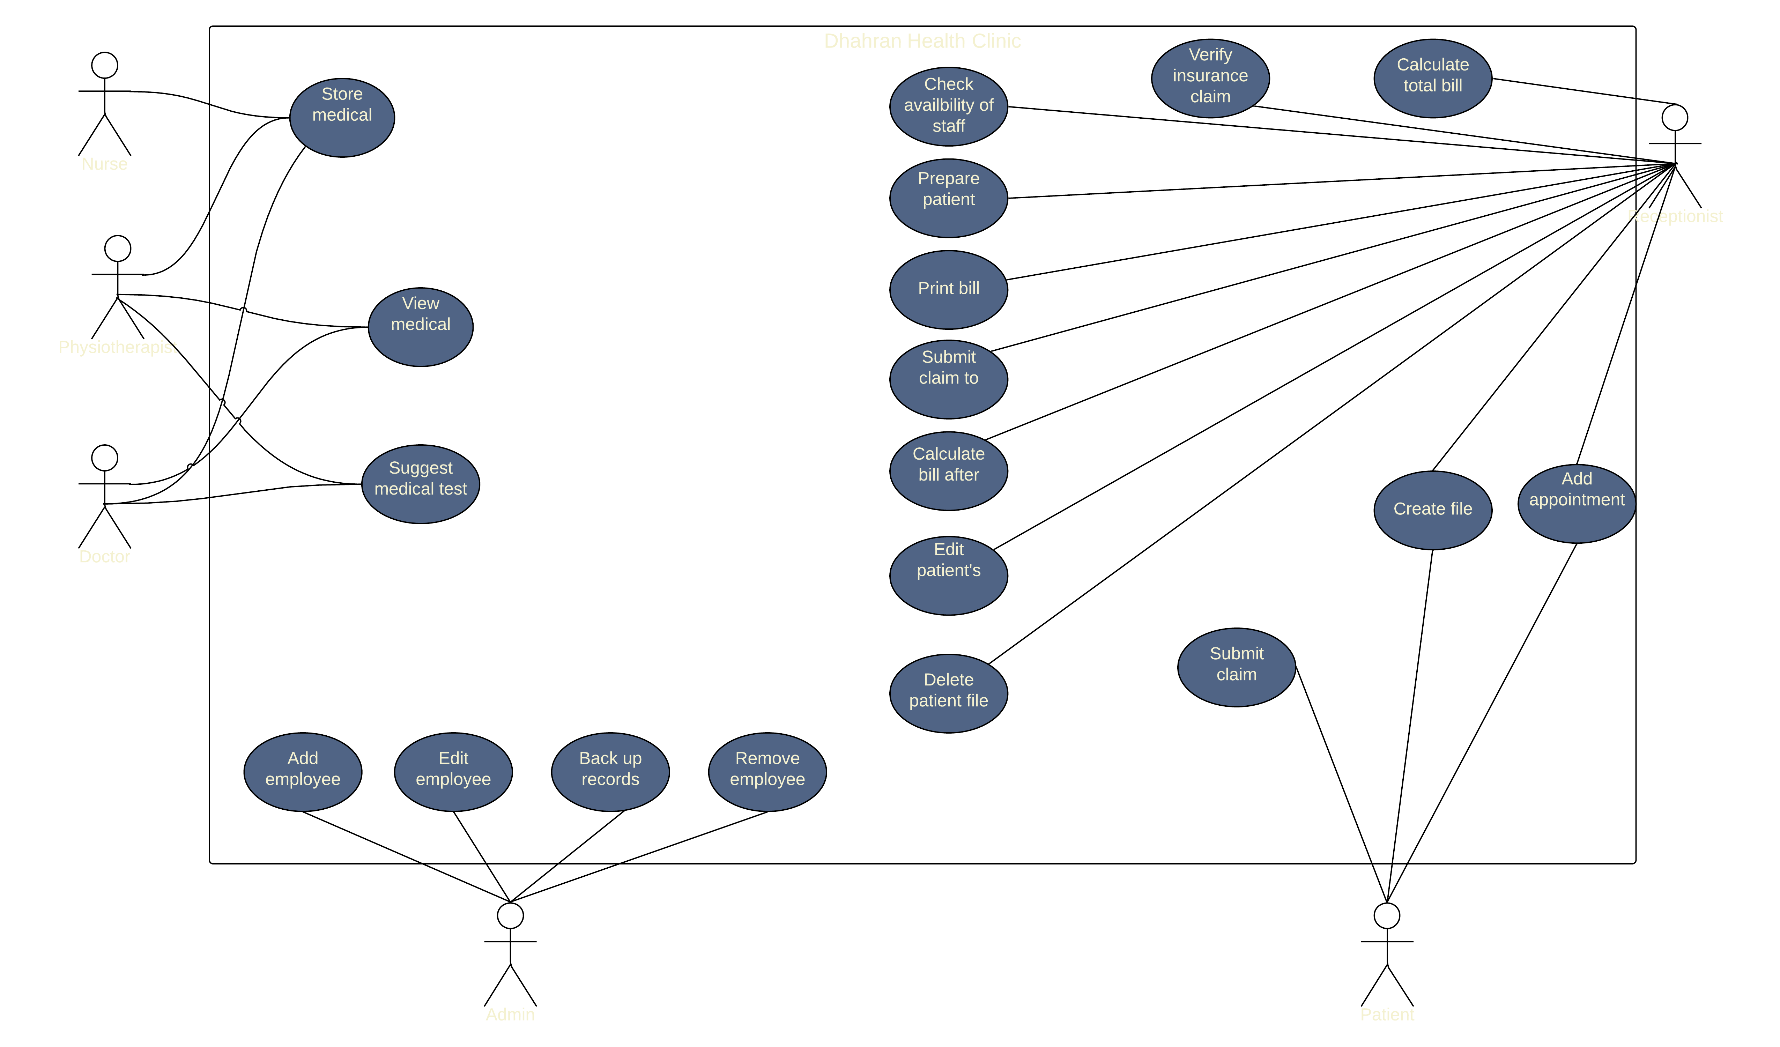
Use Case Diagram

Slide 4
Use Case Description
Back-up records | Name of use case
System admin | Actor(s):
Back-up all records in the databases. | Description of use case
1- Select the record(s) to be backed-up. 2- Select backup now. | Successful Completion Steps
None. | Alternative Steps
System admin is logged in to the system. | Pre-condition:
All records in the databases have been backed-up. | Post-Condition:
Availability of external backup drives. | Assumptions:
Create file | Name of use case
Receptionist Patient | Actor(s):
The receptionist gives the patient a form to fill, then the receptionist enters the records to the system or the user does it themselves in the system. | Description of use case
1- The receptionist enters the patient’s personal records as a form to the database. | Successful Completion Steps
1- The patient enters their name 2- Enter birthdate 3- Enter national ID 4- Enter contact info 5- Enter insurance (if any) 6- Enter password | Alternative Steps
Receptionist Logged in. Patient file does not exist. | Pre-condition:
The patient can make an appointment. The patient can request any type of medical tests. | Post-Condition:
None. | Assumptions:

Slide 5
Sketch Prototype

Slide 6
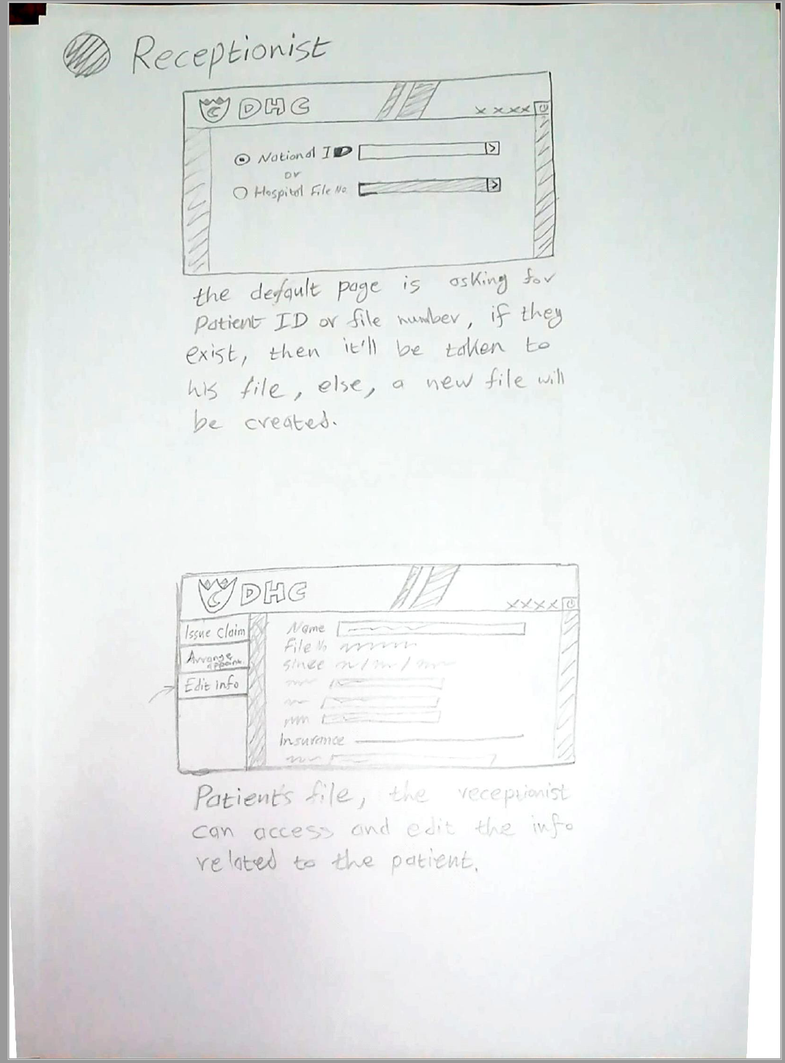
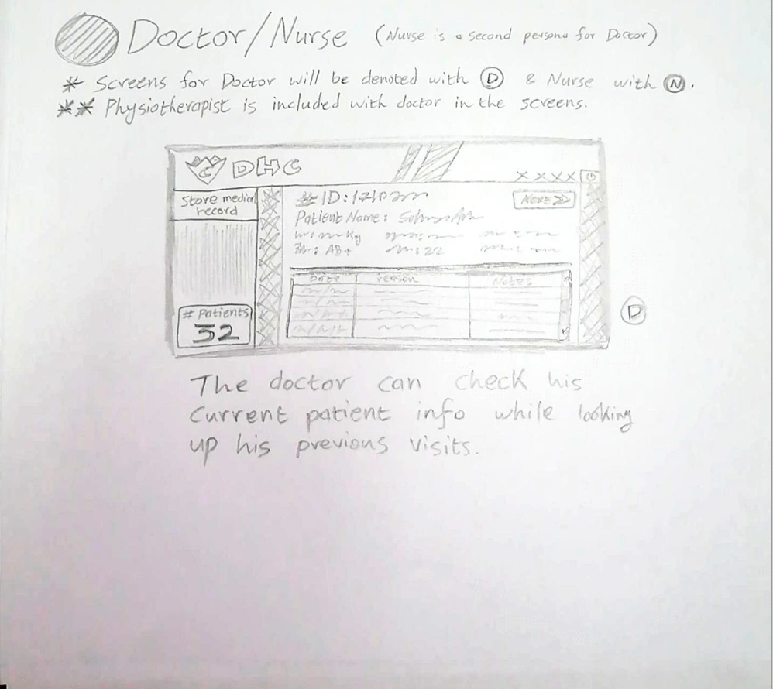
Receptionist
Doctor/Nurse

Slide 7
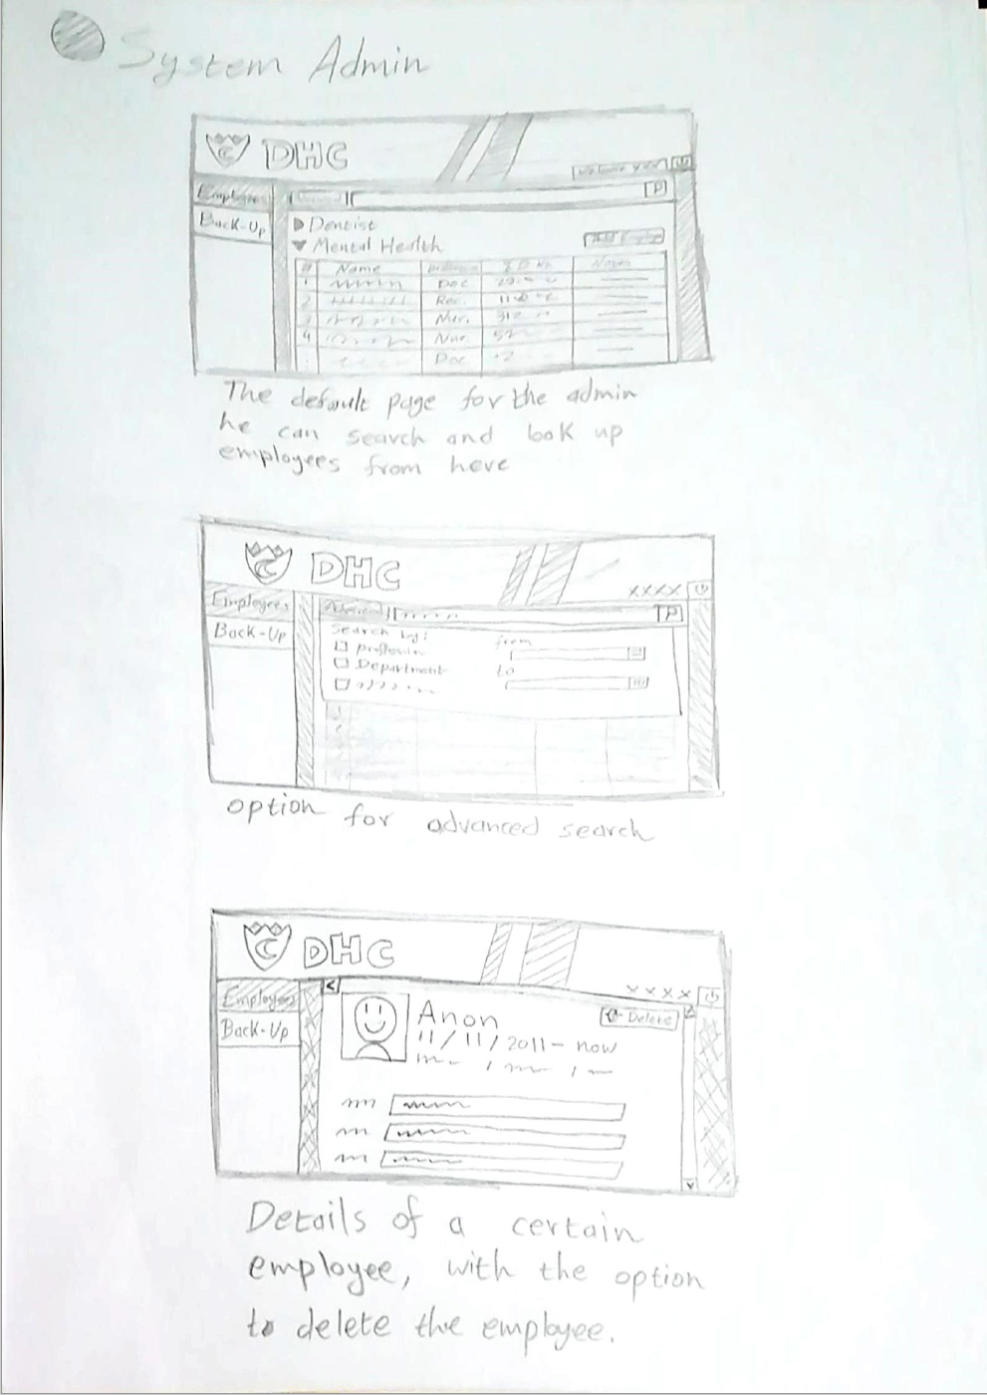
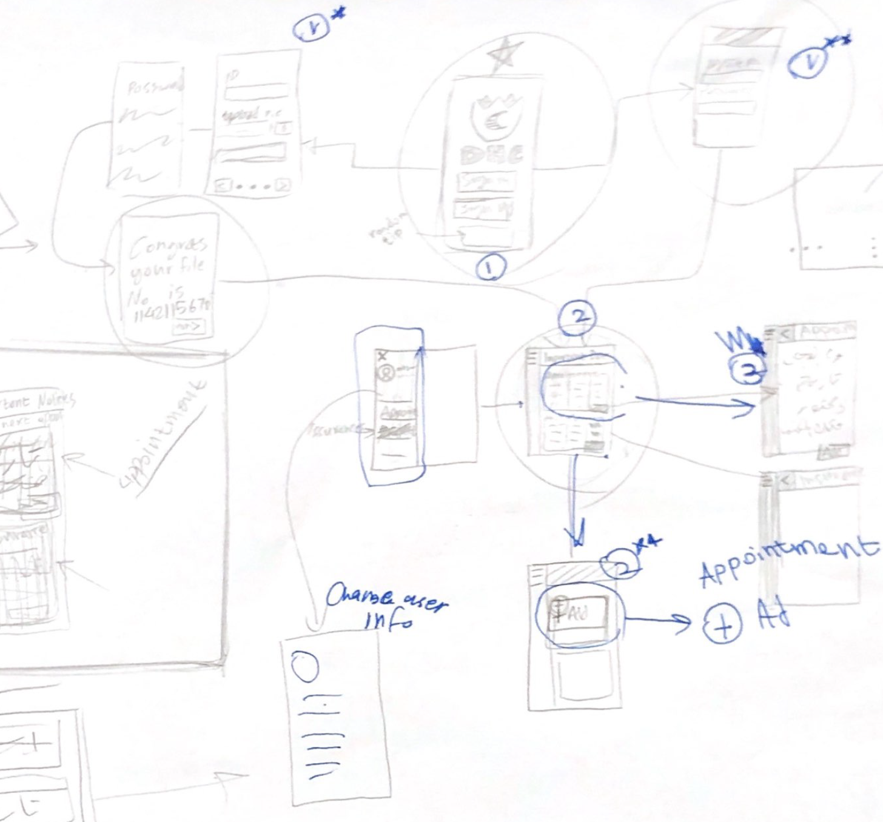
System Admin
Patient

Slide 8
Developed Prototype

Slide 9
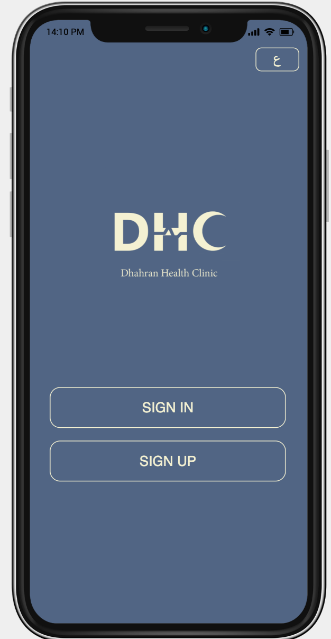
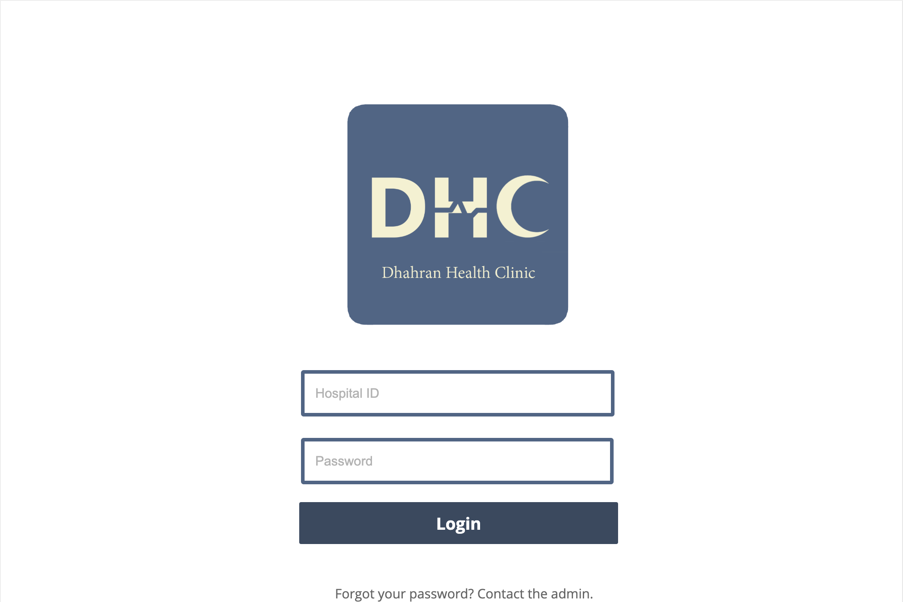

Slide 10
Design Considerations & Evaluation Criteria

Slide 11
Design Considerations
Limiting the number of fonts and colors used to no more than Splitting the complicated forms into smaller sections.
Drop down menus were used to minimize errors.
The logo was designed to stand out without using obvious symbols
The color used should be easy-to-read for most users.
Making the UI more aesthetically pleasing makes the system more usable.
Making the UI less complex makes the learning time shorter for the system.
By following Jakob’s law, making the system look similar to other systems will make it easier to use.
By following the law of uniform connectedness elements are perceived as one group of related elements.
By following Miller’s law we made screens contain not more than 7 elements to minimize memory load on the user.

Slide 12
Evaluation Criteria
Desktop Criteria:
Structure
Use of Color
Readability
Page Layout
Mobile Criteria:
Structure
Use of Color
Buttons
Navigation
Consistency
Alignment
Typography
Readability
Rating scale: 1 = Very poor, 2 = Poor, 3 = Mediocre, 4 = Good, 5 = Excellent, 6 = Very Excellent

Slide 13
Evaluation Feedback & Response

Slide 14
Desktop feedback:
Structure
Is it easy to get back to Home page?
4 (There is no home page button, but the user can easily press back button until home page is reached.)
Page Layout
Are elements sized and arranged to fit within browser window?
4 (Overall, the size of the elements is appropriate, but it is very big if the user wanted to use it in smaller window)
Overall evaluation: 5 (Excellent)
Summary: The interface is user friendly. It is clear to the user how to do the required tasks. The only possible disadvantage in the design is that 50% of the page contains dark color, which may not be appropriate for some users.
Mobile feedback:
Use of Color
Are there a good color palette and a good color relationship? Does the color palette appeal to the target audience?
6 (The background is dark, and the fonts are light, so they make good combination)
Structure
Can you navigate readily from page to page?
5 (There is no navigation bar but there is maximum of two pages for any task)
Overall evaluation: 6 (Very Excellent)
Summary: The interface is user friendly. It is clear to the user how to do the required tasks, and everything is organized according to a specific sequence.

Slide 15
Thank you for listening
Any questions? Issues? Concerns?

